Slide 1
Building and Testing Code

Slide 2

Overview
Build the Container
Running Shell in Pipeline Scripts
Run Unit Tests
Multi-Branch Pipelines
Fail Blocks

Slide 3



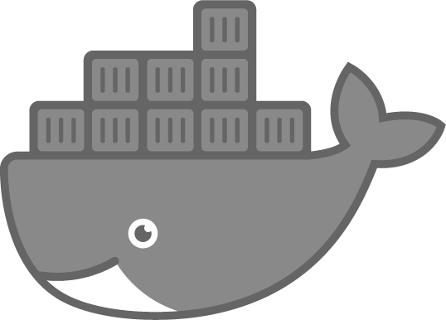

Course Pipeline

Slide 4

pipeline {
agent any stages {
Jenkinsfile
stage('Hello World’) {
steps {
echo 'Hello World’
}
}
}
}

Slide 5
pipeline {
agent any stages {
Jenkinsfile
stage('Hello World’) {
steps {
sh(script: 'echo Hello World')
}
}
}
}

Slide 6
pipeline {
agent any stages {
Jenkinsfile
stage('Hello World’) {
steps {
pwsh(script: 'Write-Output "Hello World“’)
}
}
}
}

Slide 7

Demo
Build the Container
- Running shell scripts in pipelines

Slide 8

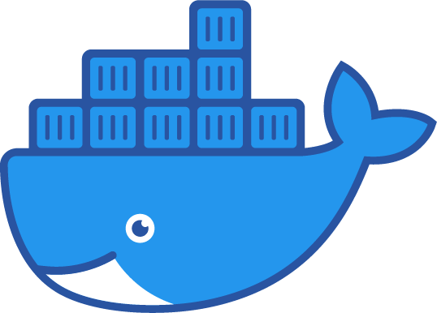
Course Pipeline

Slide 9





Unit Test Workflow

Slide 10
Multi-Branch Unit Test Workflow
master
dev
feature-n

Slide 11
Demo
Run Unit Tests
Multi-Branch Pipelines
Failure Blocks

Slide 12
